Slide 1
Introduction to Java Programming
Esther Irawati Setiawan
esther@stts.edu

Slide 2
Today’s Agenda
History of Java
Key concept of Java Programming Language
Outline of future classes
Java Programming
STTS

Slide 3



History of Java
Originated at Sun Microsystems in 1991
Part of a research project to develop a programming language called Oak
Developed by Green Team
Perfect for developing
multimedia components to enhance Web Pages
Applets became the initial use of Oak language
Programmers using internet adopted what became the Java Programming Language
Now Part of the Oracle Corporation
Java Programming
STTS

Slide 4
Benefits of Java
Object-oriented
Distributed
Simple
Multithread
Secure
Platform-independent
Java Programming
STTS

Slide 5
Benefits of Java (2)
Java requires that each variable be initialized
Java requires that each method that declares a return type, always return a value
Java comes with a large set of classes and methods
Java primitive types, such as int, are always the same size in the number of bits
Java Programming
STTS

Slide 6
Benefits of Java (3)
Java used to be thought of as being slower than C, but that's less important in recent years with computers being faster.
Java has exception-handling that requires a programmer to handle error-conditions such an Input/Output errors.
Code compiles on one Java platform can be run on other platforms that support Java without modification of either the source-code nor the byte-code
Java Programming
STTS

Slide 7
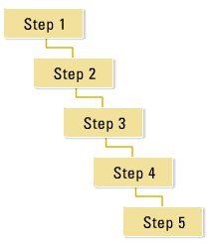
Procedural vs Object Oriented Design
Procedural Design focus on steps in a linear fashion
Java Programming
STTS

Slide 8
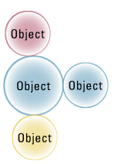
Procedural vs Object Oriented Design cont’d
Object oriented focus on objects and object interactions
Objects have state, attributes, operation, communicate with each other
Java Programming
STTS

Slide 9
Distributed
Pieces of program can be all over the internet
When executed, pieces will be brought back together
Distributed network technologies :
  Remote Method Invocation ( RMI )
  Common Object Request Broker Architecture ( CORBA )
  Universal Resource Locator ( URL )
Java Programming
STTS

Slide 10
Simple
References instead of pointers
Garbage collector
Single Inheritance
Boolean either true of false ( not 1 or 0 )
Java Programming
STTS

Slide 11
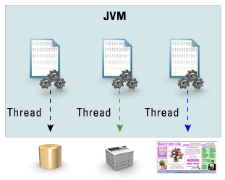
Multithread
Ability to carry on several tasks on the same time
Used in web servers and database servers
Java Programming
STTS

Slide 12

Secure
Directly memory manipulation isn’t allowed
Code validation
Applet can’t read or write on hard drive
Java Programming
STTS

Slide 13
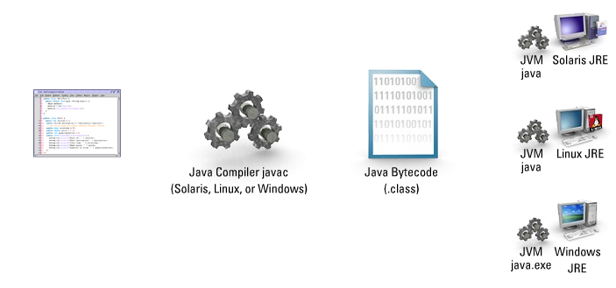
Platform Independent
Write once, compile once, execute at any platform
Java Programming
STTS

Slide 14
Java Technology Product Groups
Java Standard Edition ( Java SE )
  Standalone Applications, Distributed Applications, Applet
Java Enterprise Edition ( Java EE )
  Multi-tier enterprise Apps, eCommerce,
  Web Services Support
Java Micro Edition ( Java ME )
  Cell phones, PDAs, TV set top boxes,
  Car Navigation Systems
Java Programming
STTS

Slide 15
Java SE Versions
January 1996: first official release JDK 1.0
February 1997: JDK 1.1
December 1998: Java 2 Platform (JDK 1.2)
May 2000: J2SDK v1.3
May 2001: J2SDK v1.4 beta
2002: J2SDK v1.5.0 / J2SDK 5.0
December 2006: J2SDK v1.6.0 / Java SE 6
2011: J2SDK v1.7.0 / Java SE 7
2016: Java SE 8
Java Programming
STTS

Slide 16
Java SE 6 JDK Components
Java Runtime Environment ( JRE )
  Java Virtual Machine ( JVM ) java.exe
  Java Class Libraries
Java Compiler javac.exe
Class library documentation ( download separately )
Additional utilites
Program examples
Java Programming
STTS

Slide 17
Java IDE Tools
Three major development tools are:
JBuilder by Borland (http://www.borland.com/)
NetBeans Open Source by Sun (http://www.netbeans.org/)
Eclipse Open Source by IBM (http://www.eclipse.org/)
Other useful tools are:
Oracle JDeveloper
Code Warrior by Metrowerks (http://www.metrowerks.com/)
TextPad Editor (http://www.textpad.com/)
JCreator LE (http://www.jcreator.com/)
JEdit (http://www.jedit.org/)
JGrasp (http://www.jgrasp.org/)
BlueJ (http://www.bluej.org/)
DrJava (http://drjava.sourceforge.net/)
Java Programming
STTS

Slide 18
Getting Started
A Simple Java Application
Compiling Program
Executing Application
Java Programming
STTS

Slide 19
A Simple Application
Java is case-sensitive
//This application program prints Welcome
//to Java!
public class Welcome
{
public static void main(String[] args)
{
System.out.println("Welcome to Java!");
}
}
Java Programming
STTS

Slide 20
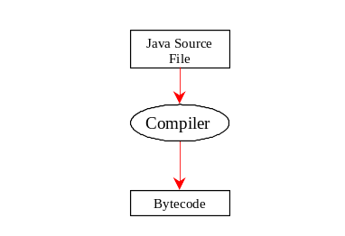
Compiling Program
On command line
  javac file.java
Java Programming
STTS

Slide 21
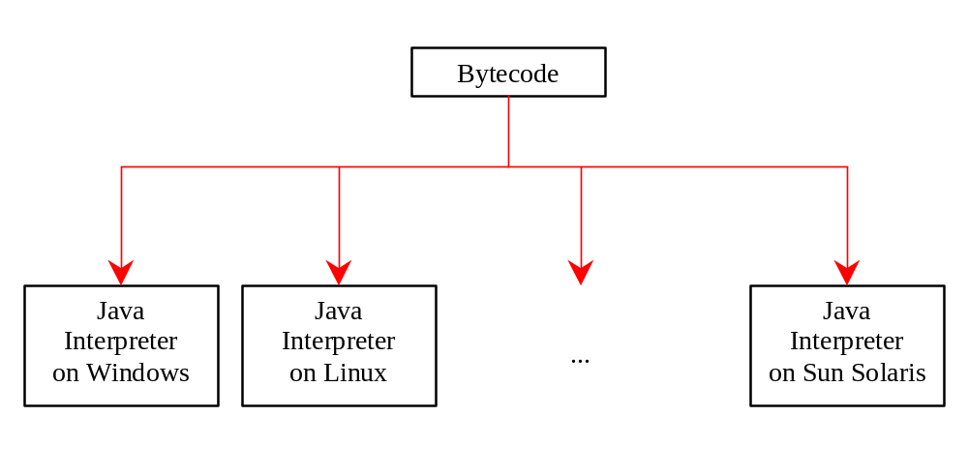
Executing Application
On command line
  java classname
Java Programming
STTS

Slide 22
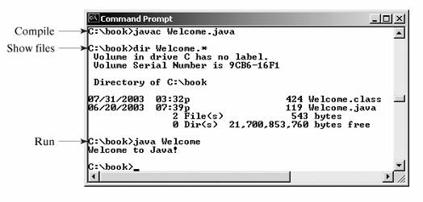
Example Output
Java Programming
STTS

Slide 23
Anatomy of a Java Program
Comments
Reserved words
Modifiers
Statements
Blocks
Classes
Methods
The main method
Java Programming
STTS

Slide 24
Modifiers
Java uses certain reserved words called modifiers that specify the properties of the data, methods, and classes and how they can be used.
Examples of modifiers are public and static. Other modifiers are private, final, abstract, and protected.
Java Programming
STTS

Slide 25
The main Methods
Every Java application must have a user-declared main method that defines where the program execution begins.
The JVM executes the application by invoking the main method. The main method looks like this:
public static void main(String[] args) {
// Statements;
}
Java Programming
STTS

